Slide 1
Artificial Intelligence
Raghu Prasad
Infidata Technologies
9845547471

Slide 2
Introduction
Raghu Prasad – BE, MS
Total of 24 years of experience
7 years as a lecturer in an Engineering College
17 Years into IT
Worked with companies like CISCO,CSC,ICICI,First Apex – NTT Data
Currently into Corporate training and consultancy
Worked with corporates and public sector
Service Offerings – In person/On-line/Corporate/Academic Institutes
Consultancy – Consultant to vendor of Atal Tinkering Lab/ECIL-ECIT, Incarnus – Healthcare Service Provider
Technologies – Java,Python,Web technologies,Java Script technologies (MEAN stack),IOT,Test Automation,Machine Learning,Artificial Intelligence,ERP,.NET
Customers – Philips,L & T,NextGen,Incarnus,Aspire system,BGS-IT,Sindhi College,Malnad Enginering College,S B College of Management, REVA University,Nagarjuna Engineering College,Dayanand Sagar University,NIT-Imphal

Slide 3
Topics
Introduction to AI,ML and Deep Learning
Introduction to Cognitive Computing
Applications of Artificial Intelligence
Applications of AI in Healthcare
History of AI

Slide 4
What is Artificial Intelligence ?
In computer science, artificial intelligence (AI), sometimes called machine intelligence, is intelligence demonstrated by machines, in contrast to the natural intelligence displayed by humans. Colloquially, the term "artificial intelligence" is often used to describe machines (or computers) that mimic "cognitive" functions that humans associate with the human mind, such as "learning" and "problem solving"

Slide 5
What is Cognitive Computing ?
Cognitive -
Relating to or involving the processes of thinking and reasoning
Cognitive computing (CC) describes technology platforms that, broadly speaking, are based on the scientific disciplines of artificial intelligence and signal processing. These platforms encompass machine learning, reasoning, natural language processing, speech recognition and vision (object recognition), human–computer interaction, dialog and narrative generation, among other technologies

Slide 6
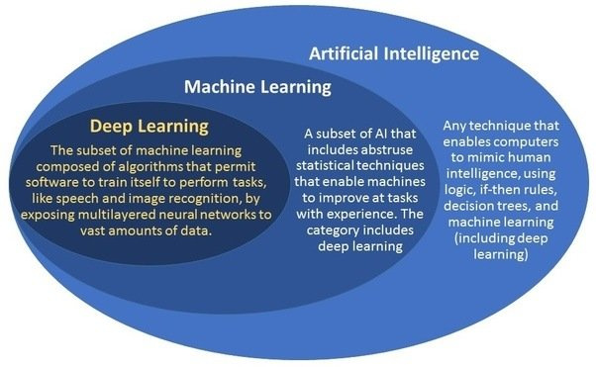
What is AI/ML/DL ?

Slide 7
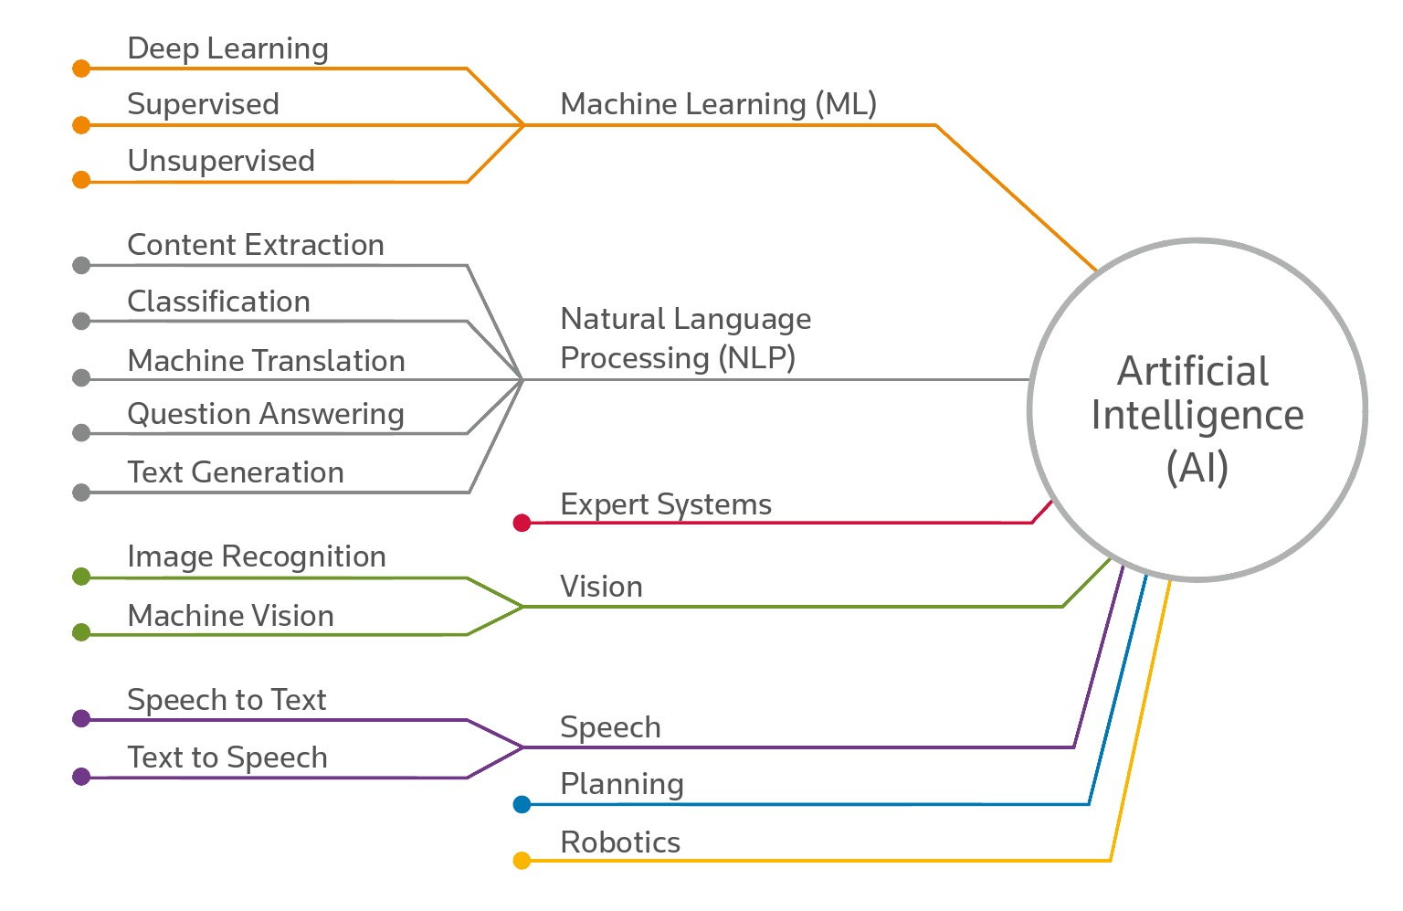
What is Artificial Intelligence ?

Slide 8
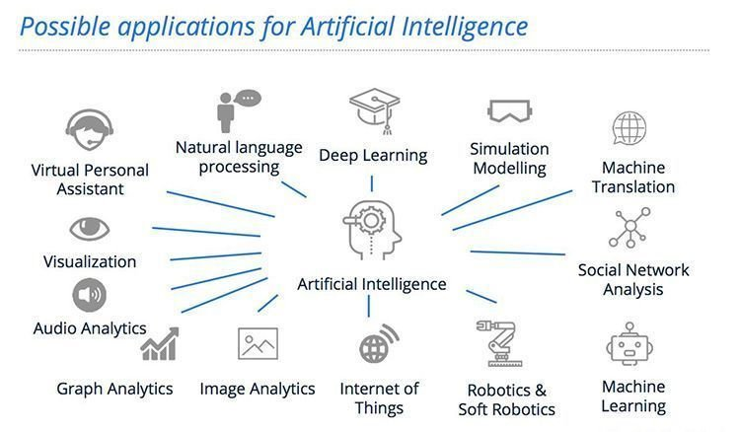
AI – History

Slide 9
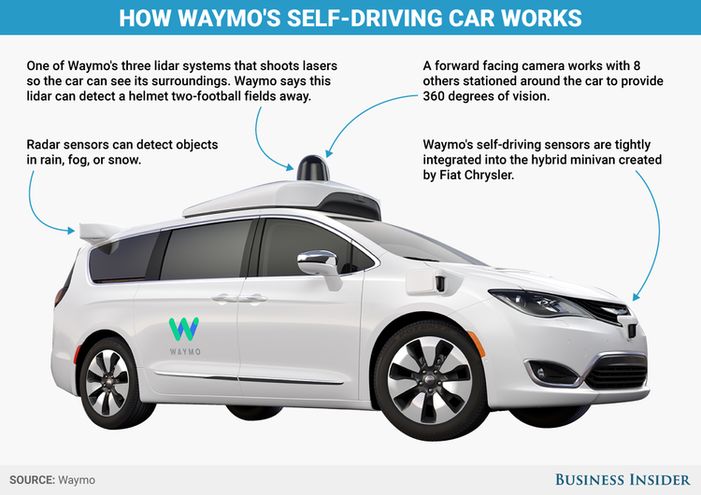
Google’s AI Products

Slide 10
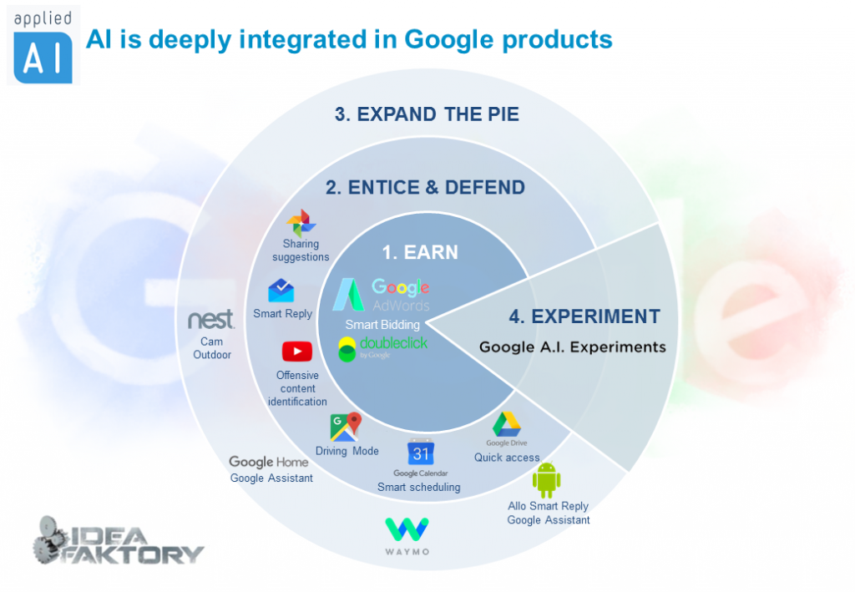
Google’s AI Products

Slide 11
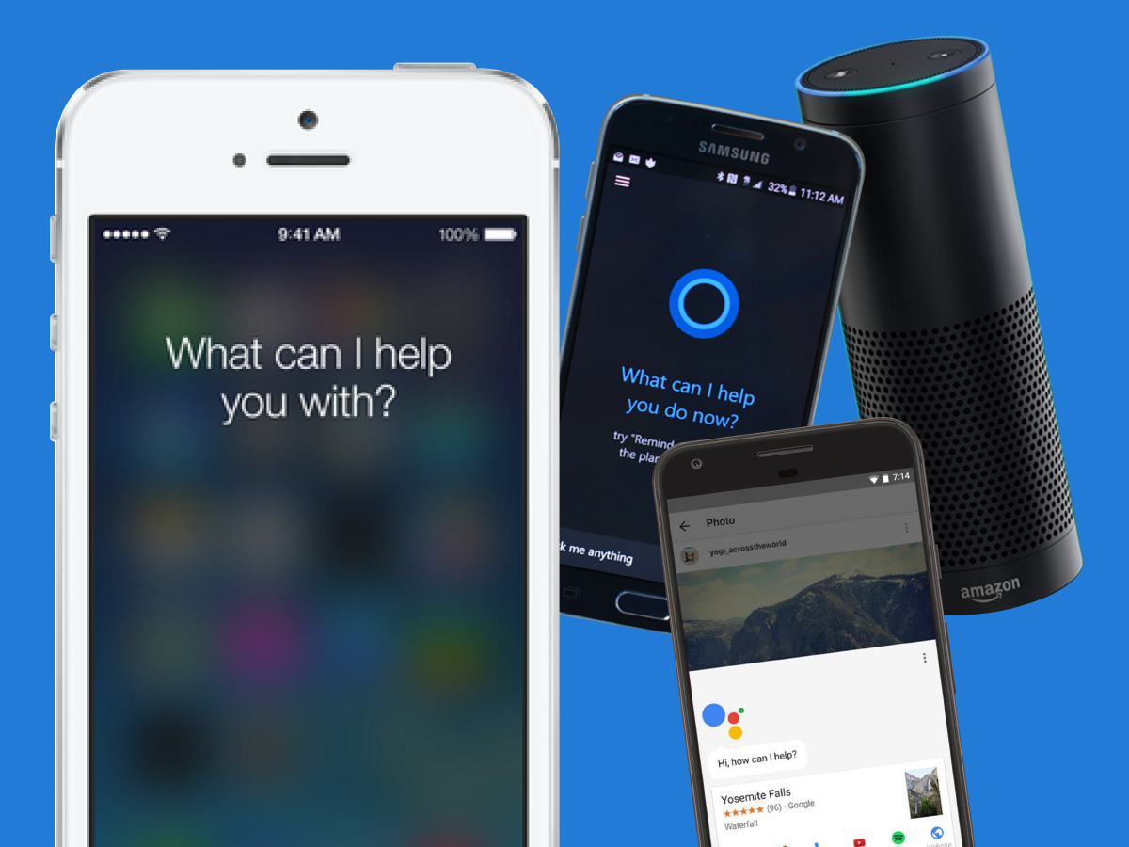
Personal Assistants

Slide 12
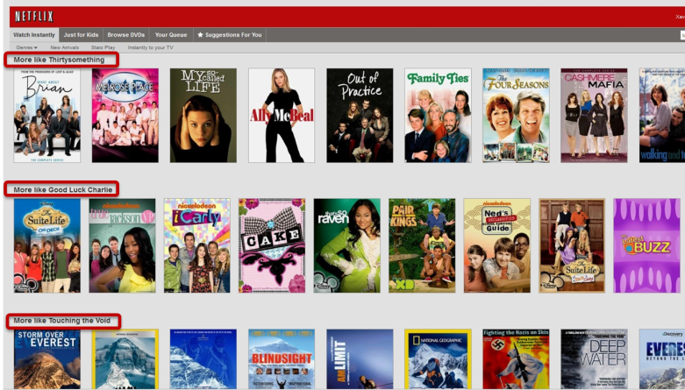
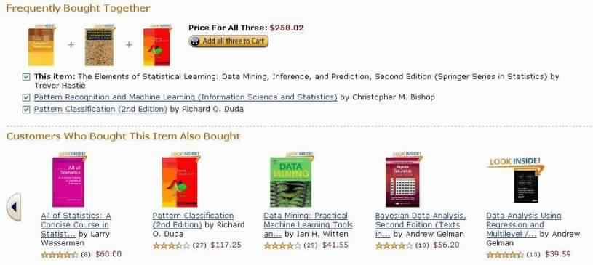
Recommendation Systems

Slide 13
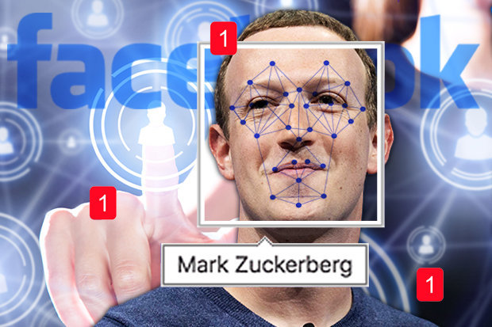
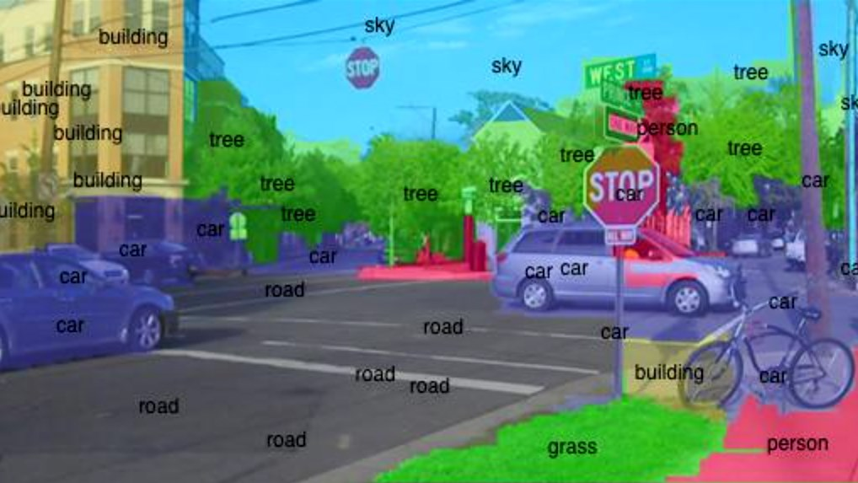
Face/Object detection

Slide 14
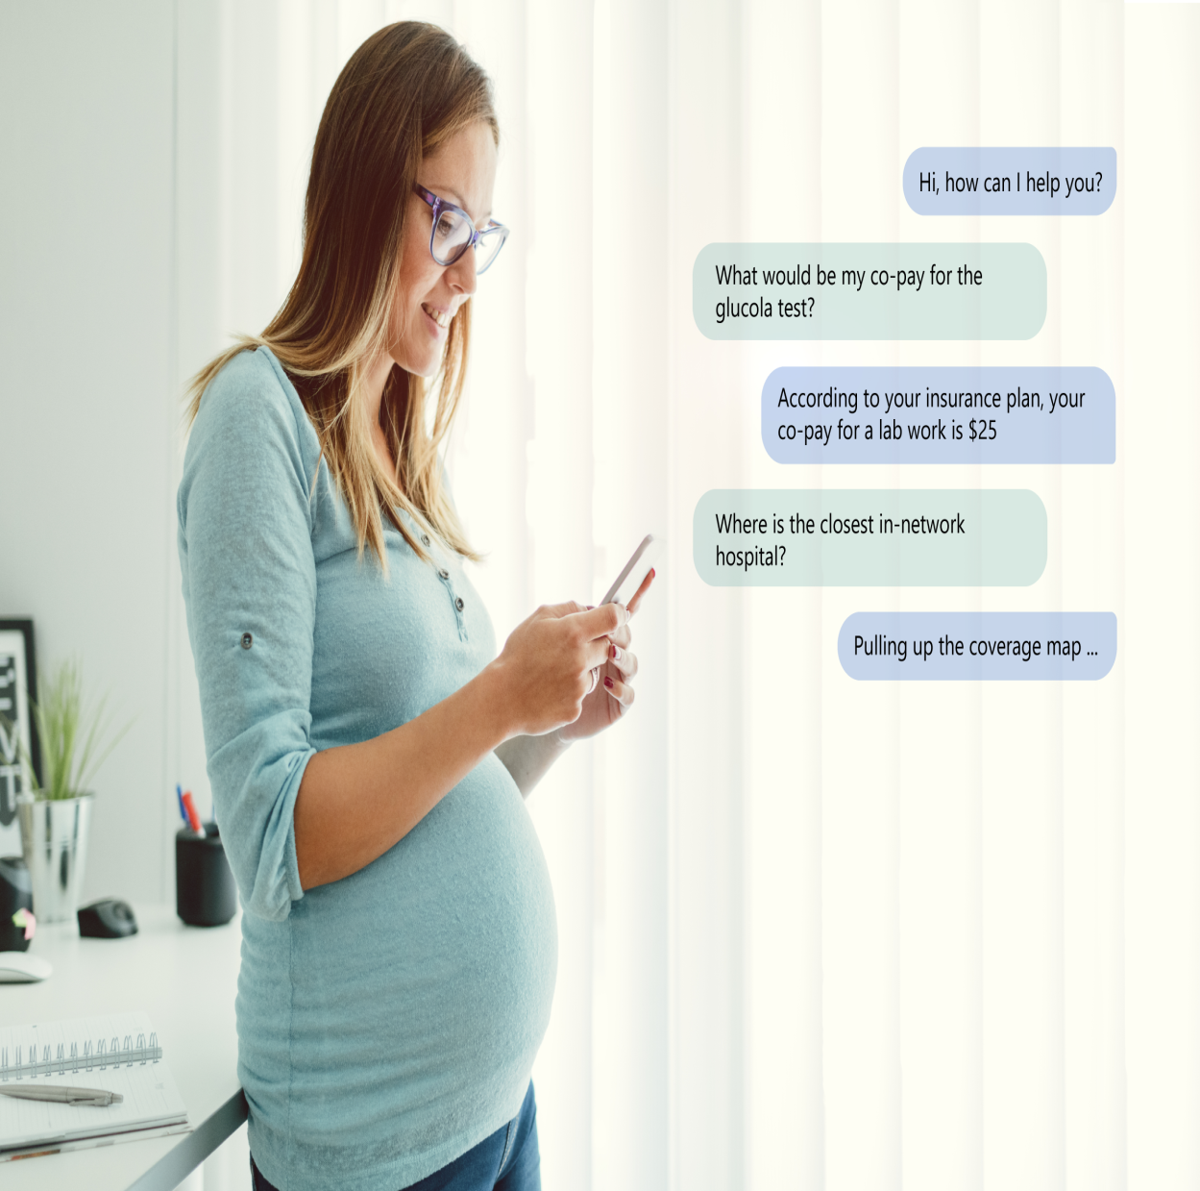
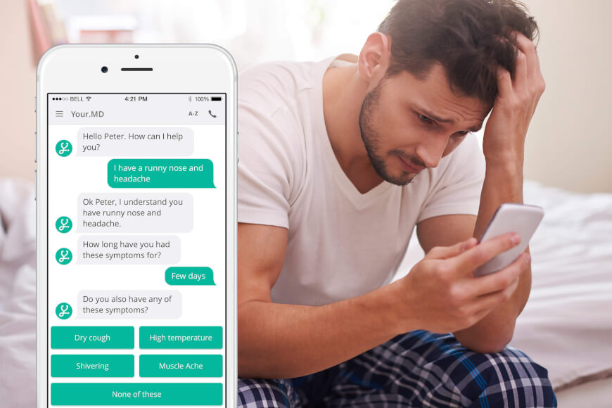
AI – Healthcare chatbots

Slide 15

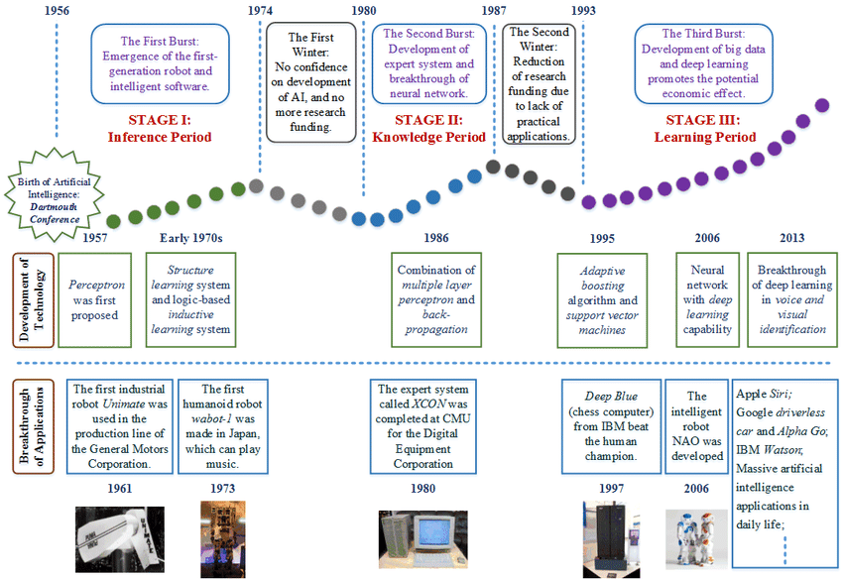
AI – History

Slide 16
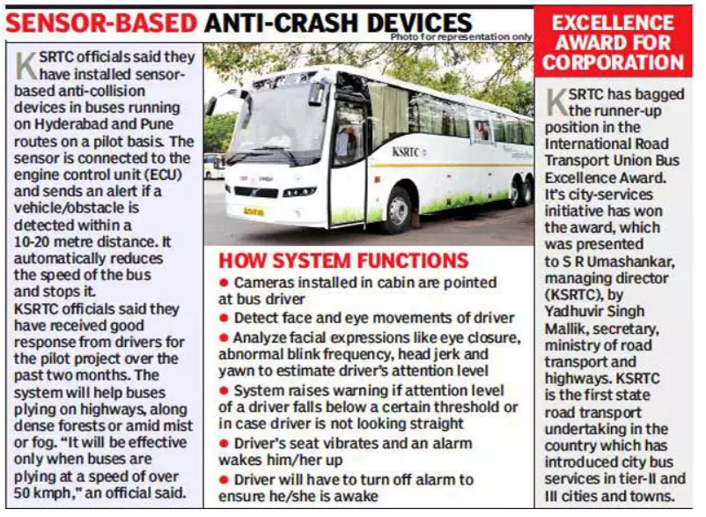
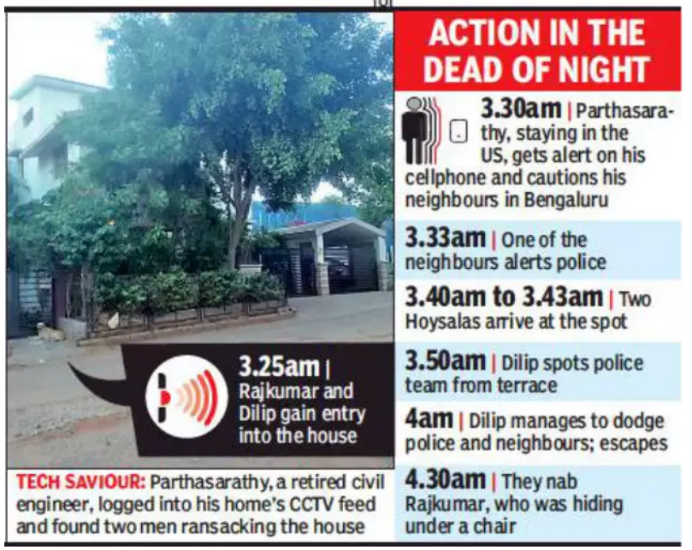
AI in News

Slide 17
Thank You
Raghu Prasad
9845547471

